Slide 1
Outage Readiness Index (ORI)

Slide 2
Outage Tracker Module Overview
5. Comprehensive Outage Phases
Initiation to Execution
Task-Based Workflow
Dynamic Deadlines
6. Action Roles Setup
Define Roles for Phase Access
7. Real-Time Outage Tracking
Assigning Actions to Users
Monitoring Outage Progress
8. Enhanced User Access Control
Ensure Data Security
9. Streamlined Outage Management
Increase Efficiency and Accountability
10. Visualize and Manage Outage Lifecycles
Dashboard Insights
Role-Based Access Control
User-specific access to modules and features
Key Functionalities
Equipment Management
Long-Term Outage Planning
Outage Phases Management
Action Roles Configuration
Track Outages and Actions
Seamless Equipment Management
Add, Update, or Delete Equipment (Units)
4. Long-Term Outage Planning
Define Outage Types and Dates for Equipment

Slide 3
Process Steps
User Authentication
Users log in with their credentials.
Role-based access determines their module permissions.
Equipment Management
Add, Update, or Delete Equipment (Units).
Maintain an up-to-date inventory.
Long-Term Outage Planning
Define Outage Types and Dates for Individual Equipment.
Strategically schedule outages for maintenance.
Outage Phases Management
Create Outage Phases (Initiation to Execution).
Specify Tasks and Dynamic Deadlines.
Action Roles Configuration
Set Up Action Roles for Phase Access.
Assign responsibilities and access rights.

Slide 4
Process Steps
Track Outages and Actions
Register Outages Corresponding to Phases.
Assign Actions to Users for Task Execution.
User Access Control
Ensure Secure Data Access.
Manage User Permissions and Data Integrity.
Real-Time Monitoring
Keep Track of Outage Progress.
Monitor Action Completion and Milestones.
Data Visualization
Utilize Dashboard Insights.
Gain a Comprehensive Overview of Outage Lifecycles.

Slide 5
S Curve
S-Curve Visualization:
Utilizes Power BI to create an S-curve chart.
Monthly Progress Tracking:
Displays monthly task completion progress on the Y-axis.
Equipment Mapping:
Associates each curve with specific equipment or outage.
Decision Support Tool:
Enables data-driven decision-making for resource allocation and scheduling.
Visual Insight:
Provides a visual representation of outage progress, helping identify delays and bottlenecks.

Slide 6
S Curve
S-Curve Visualization:
Utilizes Power BI to create an S-curve chart.
Monthly Progress Tracking:
Displays monthly task completion progress on the Y-axis.
Equipment Mapping:
Associates each curve with specific equipment or outage.
Decision Support Tool:
Enables data-driven decision-making for resource allocation and scheduling.
Visual Insight:
Provides a visual representation of outage progress, helping identify delays and bottlenecks.

Slide 7
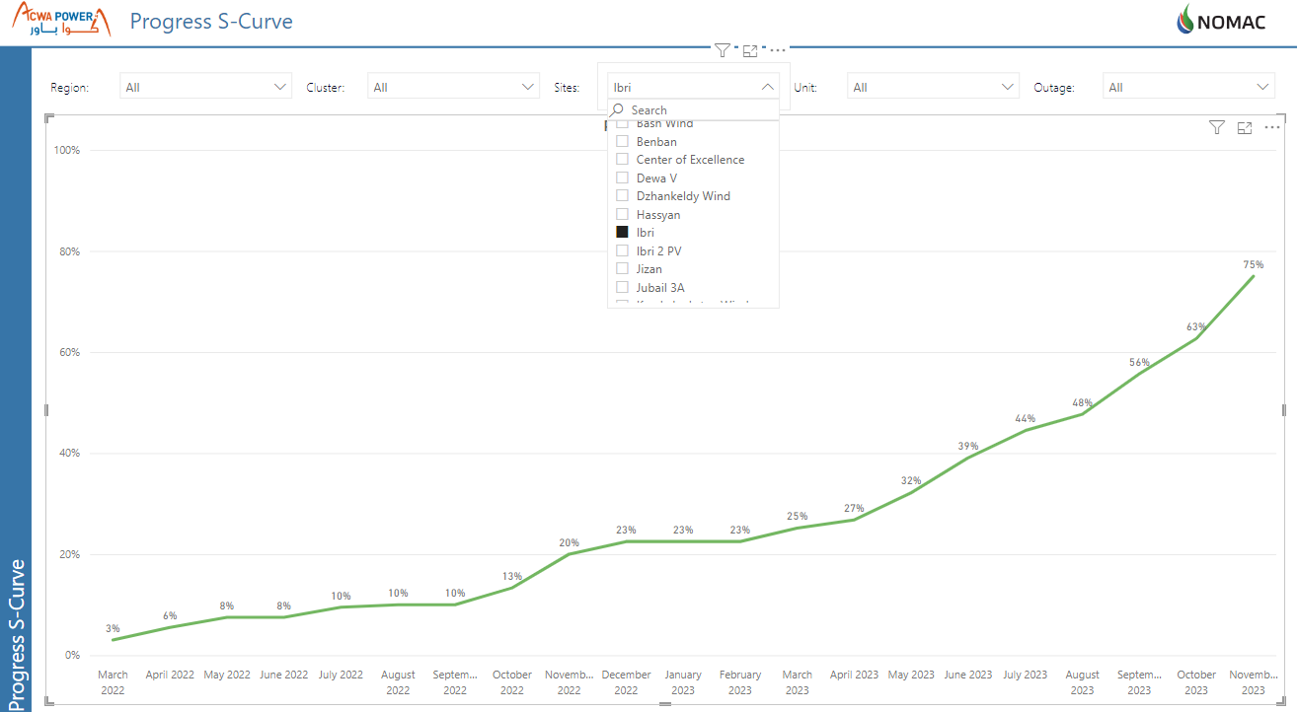
S Curve

Slide 8
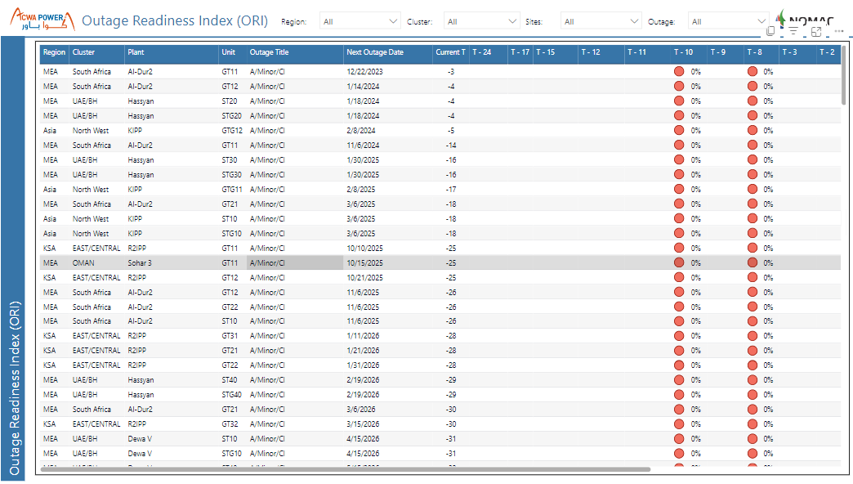
Outage Readiness Index

